Slide 1
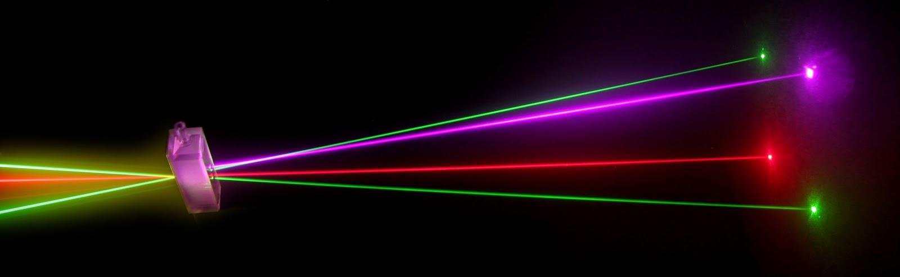
“Laser Technology and Applications” 16B1NPH533 Lecture 37
Argon Ion laser and
Krypton Ion laser

Slide 2
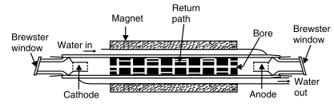
Argon Gas Laser
Four level laser; Operates in Visible region over wavelength, 351 - 520 nm
Most powerful CW laser operating in visible region (Power ∼100W)
Extensively used in laser light shows
Provides approx 25 Visible and 10 UV wavelengths
Active medium; Ar gas
Active centres; ionized Ar-atoms
A narrow water cooled ceramic tube for arc discharge
Schematic of a typical ion laser tube
Anode and cathode space communicate through a return path which ensures free circulation of gas.
A magnet surrounds the discharge tube to restrict the discharge area and increase the concentration of ions along the axis of tube.

Slide 3
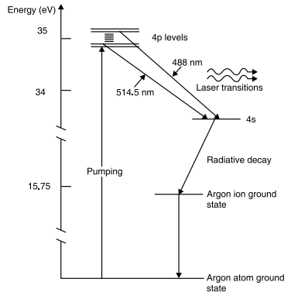
Initial HV ionizes the gas to conduct current
Electrons transfer energy to Ar-atoms, ionize them and raises the ions to a group of high energy levels.
Different process populate the
metastable state (4p level)
Three possible are:
Electron collision with Ar⁺ ions in ground state
Collision with ions in metastable
state
Radiative transitions from higher states.
Conditions for P.I. satisfied between 4p and 4s levels.

Slide 4
Most important and more common are: 488 nm (Blue) and 515 nm (Green)
Ar⁺ ions quickly drop from lower laser level to ground state of the ion by emitting UV-light at 740Aº.
Available for further action as UV light
Any desired wavelength can be selected through the cavity optics (using small prisms or gratings)
During operation, positive ions collected at cathode; neutralized and slowly diffuse back into discharge ⇒ leads to pressure gradient
A return path is provided between anode and cathode to equalize the pressure
Laser needs active cooling
Argon lasers used extensively in Eye Surgery; For treatment of Diabetic retinopathy, Retinal detachment, Glaucoma and Macular degeneration

Slide 5
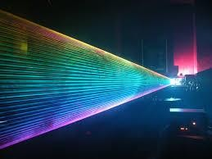
Krypton Ion Laser
Resembles the Ar-ion laser in energy levels and operation
Provides different laser wavelengths
Dominant Outputs: 4067Aº, 4131Aº, 5309Aº, 5682Aº, 6471Aº, 6764Aº
A broader spectrum of wavelengths
Used in multi-colour displays
Combination of Ar laser & Kr laser demonstrate beautiful multi colored laser shows.

